Slide 1

Government of Karnataka
Department of Collegiate and Technical Education
GOVERNMENT ENGINEERING COLLEGE, NARGUND
Department of Computer science and Engineering
Phase –II Presentation on
“A Modern Smart-Voting-Platform for Digital Election Management ”
Under The Guidance of
Prof. NANDA HANCHINAL
Under the Co Guidance
Prof. Deepa M
NAMES
USN
1.BASAPPA BALURAGI 2NR22CS006
2.NAVEENGOUDA M K 2NR22CS022
3.PRAVEEN MATTI 2NR22CS026
4.RAGHU M N 2NR22CSO29

Slide 2
Table of contents
Introduction
Problem Statement
Objectives
Literature Survey
System Architecture
High level Design
Low level Design
Flow chart
Implementation
Result Discussions
Conclusion
References

Slide 3
Introduction
Traditional voting systems face issues like long queues, manual errors, and security risks.
The Smart Voting System using Android aims to make the voting process digital and efficient.
It allows users to vote securely through their Android smartphones.
Aadhaar number , Date of Birth (DOB) and OTP are used for voter authentication.
The system ensures privacy, transparency, and accuracy in the voting process.
It reduces human errors, saves time, and increases voter participation.
This project promotes a secure, accessible, and technology-driven election process.
Voting is an essential part of democracy that allows citizens to choose their leaders.

Slide 4
Problem Statement
The problem is to design and develop a Smart Voting System that ensures secure voter authentication, prevents multiple voting, protects voter privacy, and allows efficient, transparent, and tamper-proof vote recording and counting.

Slide 5
Objectives
Ensure voter authentication
Enhance security
Promote accessibility
Improve transparency
Reduce human error
Save time and resources
Support real-time vote monitoring
Prevent duplicate voting
Enable easy result computation

Slide 6
Literature Survey
S.No | Author / Year | Title / Approach | Key Features
1 | Y. V., M. Udaif P., N. V. S., N. K. Biju, F. Sali, and L. Sebastian,2024 | A Survey on E-Voting Systems Using Blockchain | Blockchain-based e-voting improves election security by ensuring transparency, tamper resistance, and voter anonymity, increasing trust in digital elections.
2 | Y. Tahboub, A. Revilla, J. Lynch, and G. Floyd,2025 | Blockchain-Based Secure Online Voting Platform Ensuring User Anonymity, Integrity, and End-to-End Verifiability | Blockchain-based voting system ensures secure, anonymous, and verifiable online elections.
3 | G. Singh, S. Wable, & P. Kharose,2021 | A Review of E-Voting System Based on Blockchain Technology | Reviews blockchain e-voting methods, discussing security challenges and identifying research gaps for improved smart voting systems.
4 | A. Mishra, S. Khan, A. Meesh, S. Kumar | Smart Online Voting System | Proposes a secure and accessible online voting system that enables remote voting and increases voter participation.

Slide 7
System Architecture
Presentation Layer
Presentation Layer (Frontend – Android App):
This is the user-facing layer that interacts directly with voters and government officials.
Technology examples: Android Studio, XML, Java, Kotlin
Profile,
Home, Vote
Fragmen
Login Acti
ts
vit
y
Application La
yer
Application Layer (Backend Server):
This is the logical layer where the voting logic handle all communication between the app and database.
Technology examples: Java
Authentication
Profile
Election
Manager
Manager
Manager
Notification Helper
Data Layer (Database Server):
This is the storage layer where all persistent data is kept.
Technology examples: MySQL, Firebase Realtime Database
,JSON File
Data Layer
JSON File
Asset Data
Shared Prefernces

Slide 8
High level design
Voter App
(web/Mobile interface)
System Architecture:
Presentation Layer: Android app for voter/admin interface
Application Layer: Handles authentication, vote logic
Data Layer: Database for voters, candidates, and results
Authentication module
Main Modules:
Voter Registration – Add voter info (Aadhaar, DOB, etc.)
Authentication – Verify user credentials
Voting – Cast and record votes securely
Result Module – Instant and transparent result display
Application Server
Technologies Used:
Frontend: Android (Java, Kotlin, XML)
Backend: Java
Database: MySQL ,Firebase,JSON File
Authentication: Aadhaar ,DOB,OTP
Database
Results Monitoring

Slide 9
Low-Level Design
System Overview:
Focuses on internal logic, database, and module-level flow
Defines how each function works inside the system
Key Modules:
User Interface (UI): Android screens for login, register, vote
Authentication Module: Verifies voter identity (Aadhaar/OTP)
Voting Module: Displays candidates & records encrypte votes
Admin Module: Adds candidates, manages election & results
Database Layer: Stores voter, candidate & vote data securely
Database Design:
Voter_Details: Voter_ID, Aadhaar_No, Password
Candidate_Details: Candidate_ID, Name, Party
Vote_Record: Vote_ID, Candidate_ID
Admin_Details:Admin_ID, Username, Password
Election_Details: Election_ID, Date, Status

Slide 10
Flow chart
START
LAUNCH SV APP
USER LOGIN
ADMIN LOGIN
USER DASHBORD
ADMIN DASHBORD
HOME
LIST
VOTE
RESULT
ACCOUNT
HOME
USERS
ELECTION
PARTIES
RESULT
EDIT EMAIL
UPLOAD NEW PROFILE
ELIGIBILITY FEEDBACK ON APP
ADD
EDIT
DELETE RESOLVE FEEDBACK
PUBLISH
COUNT
THANKS FOR USING SMART VOTING APP / END

Slide 11
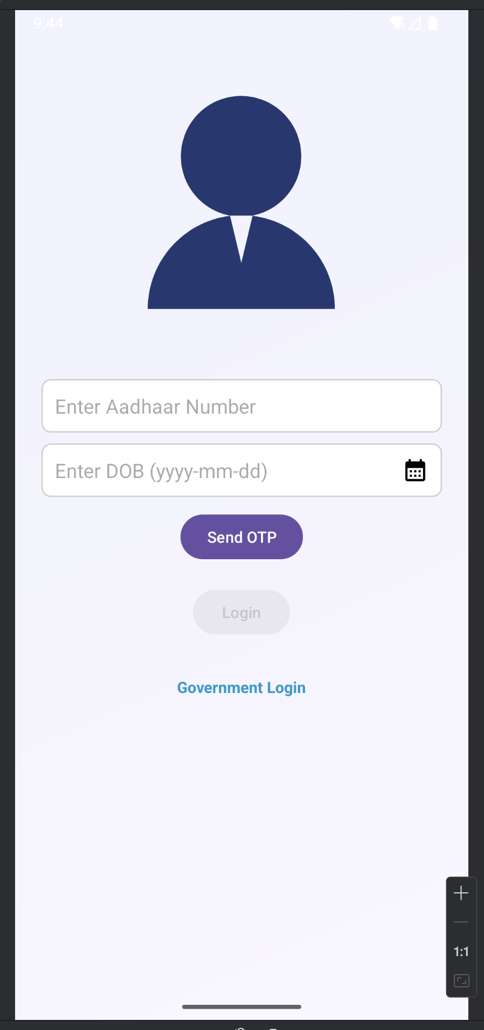
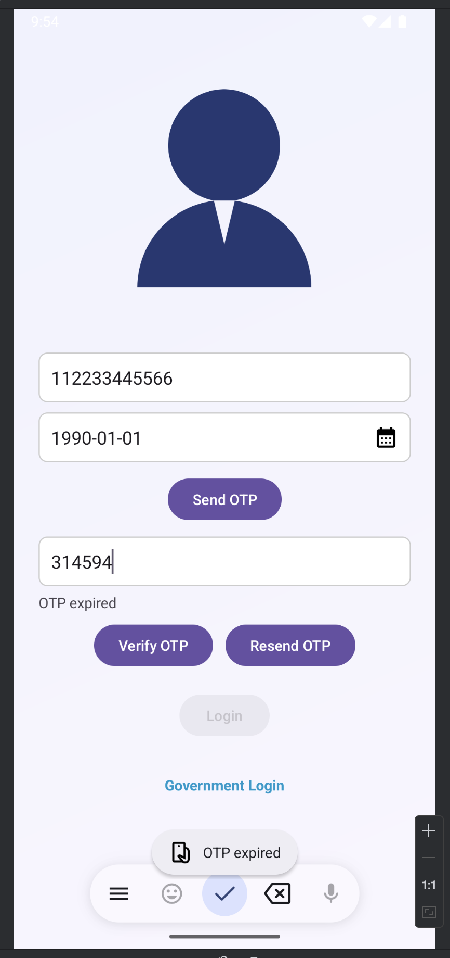
Implementation
This project proposes a Smart Voting System that leverages modern technology and ID proof-based authentication to provide a secure and efficient voting experience.

Slide 12
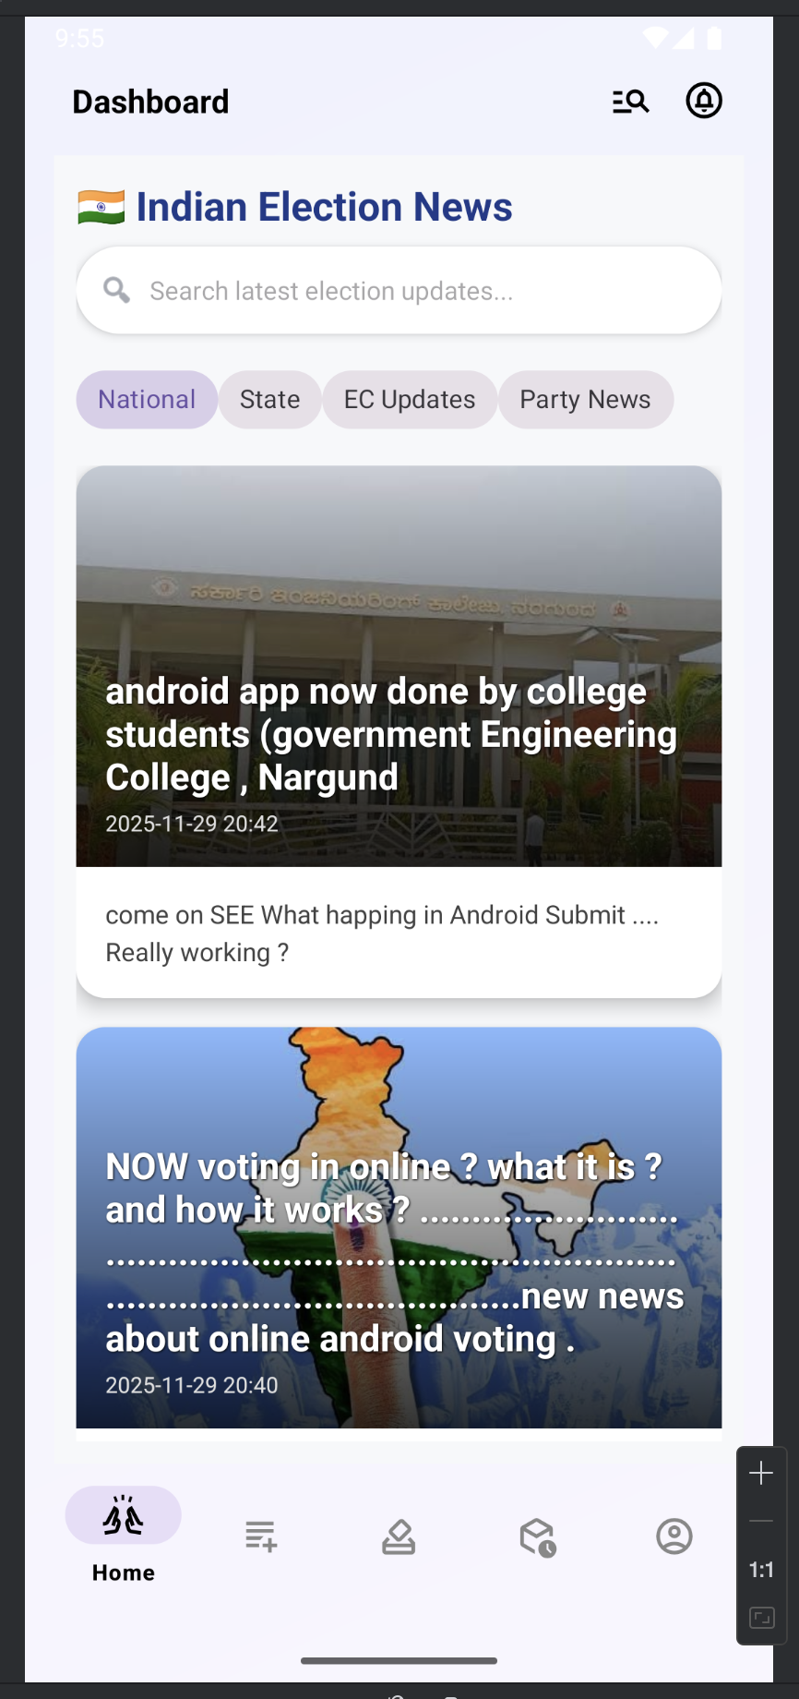
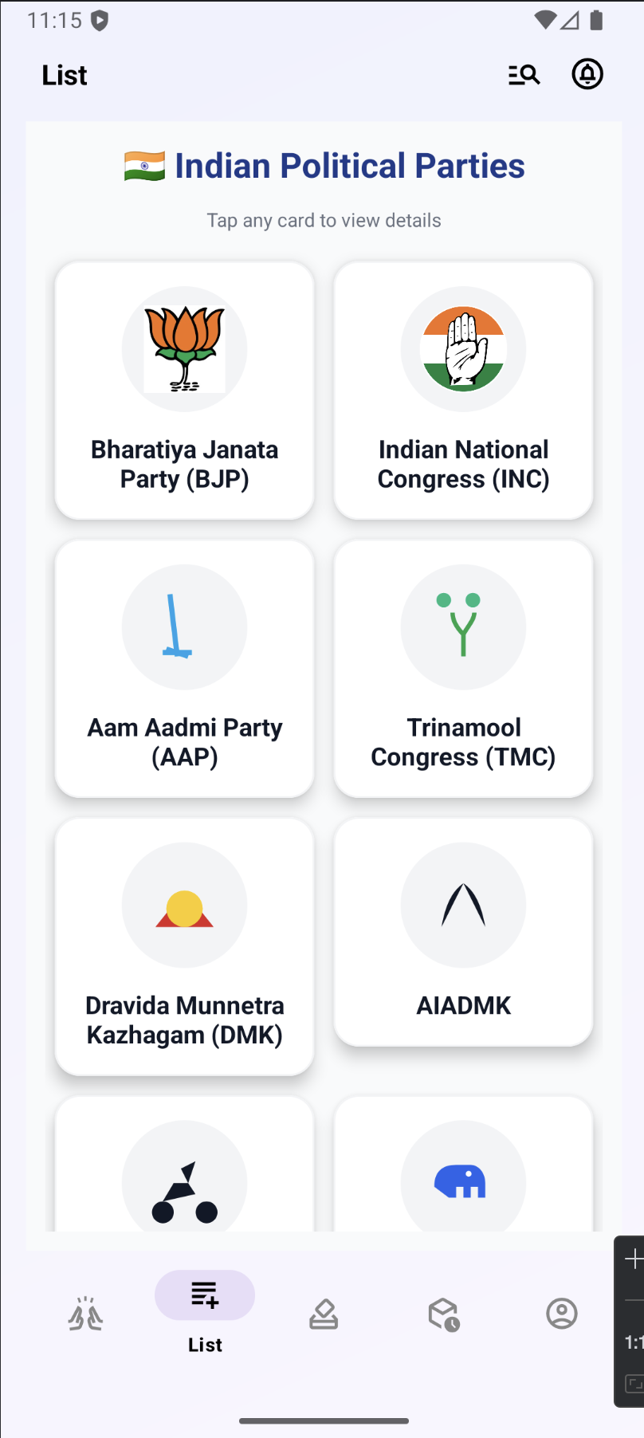
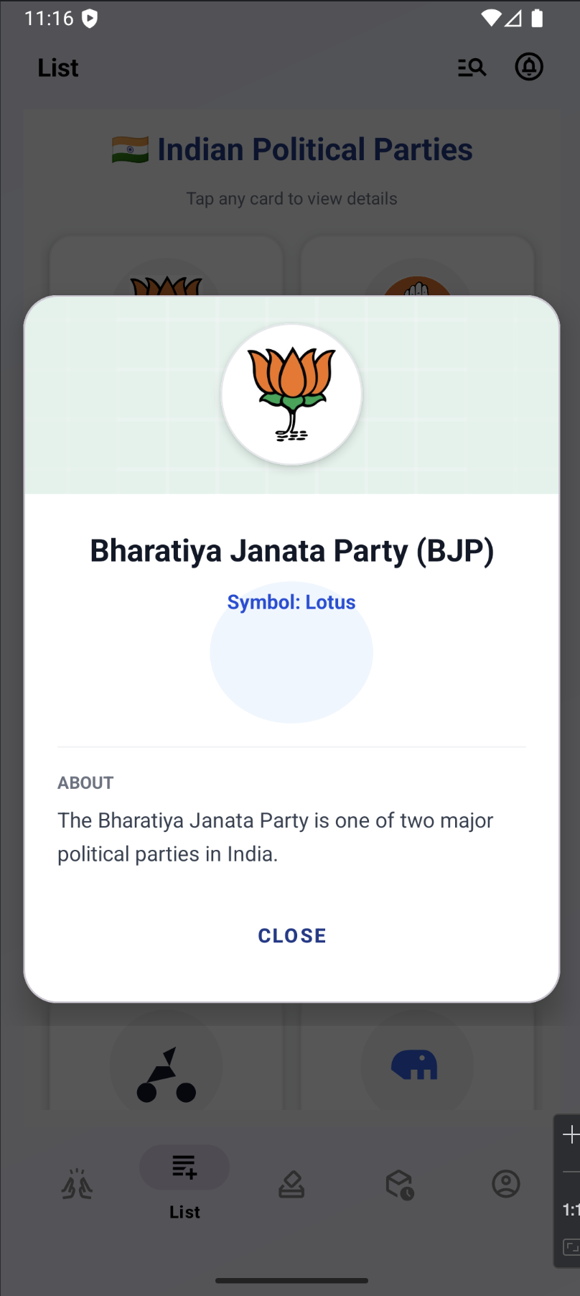
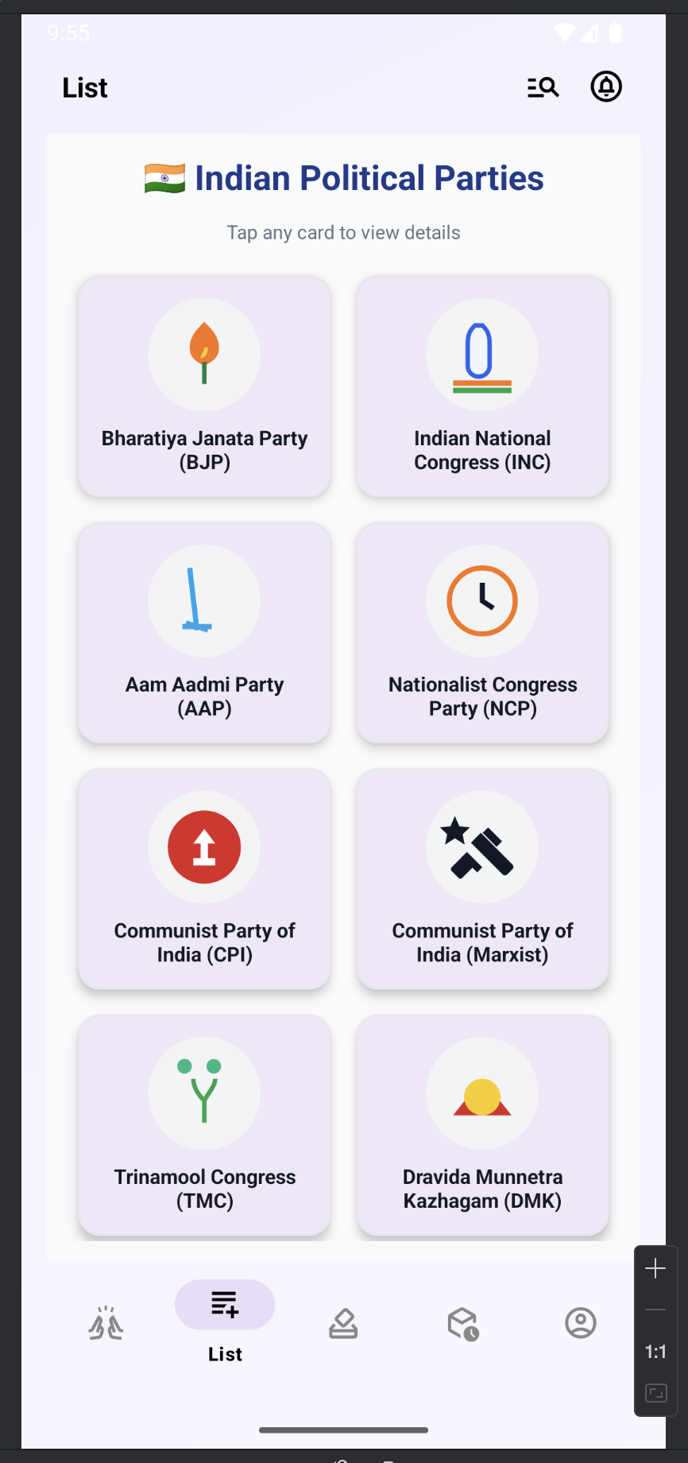
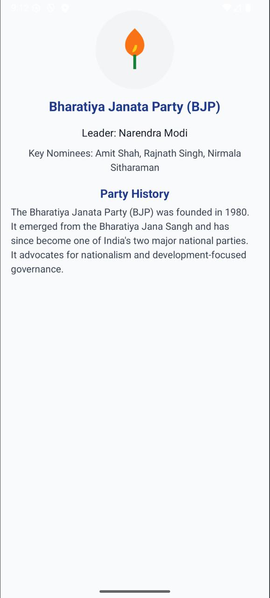
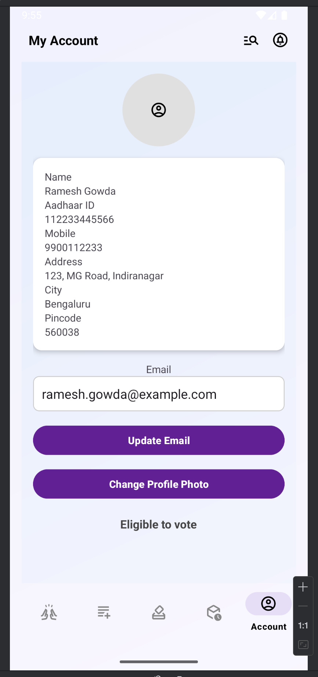
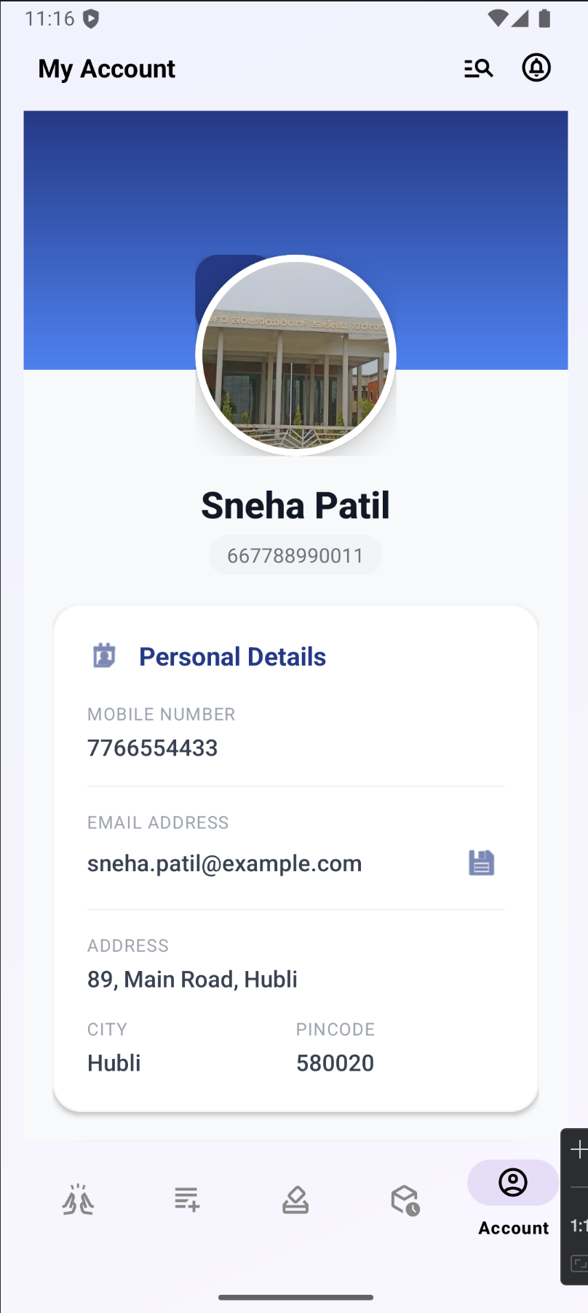

Slide 13
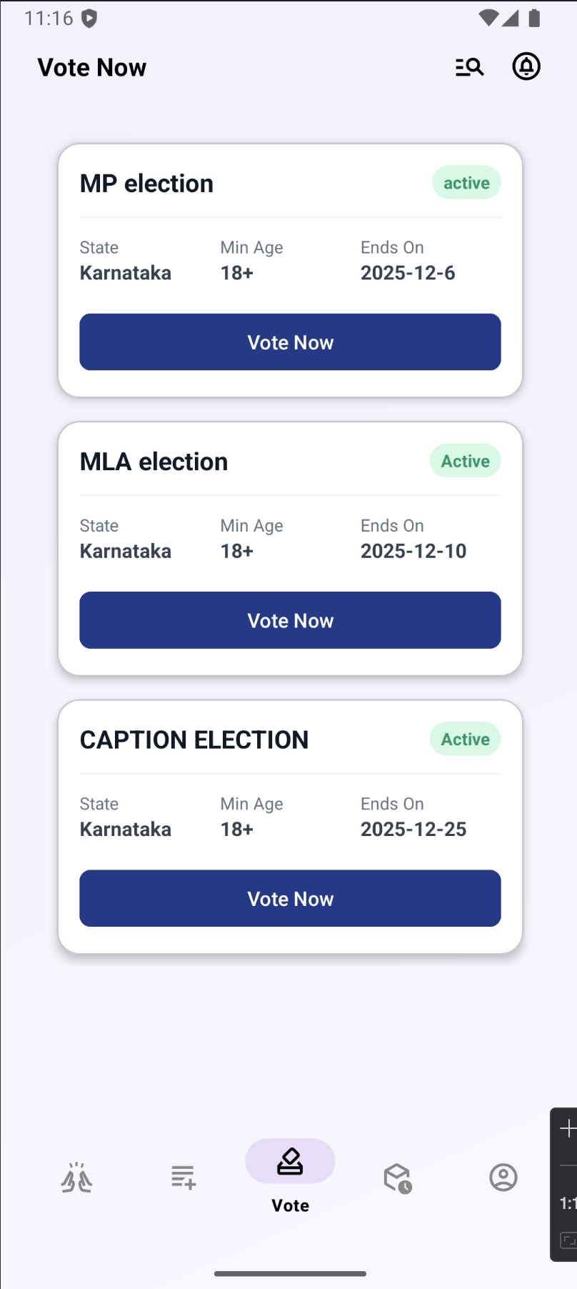
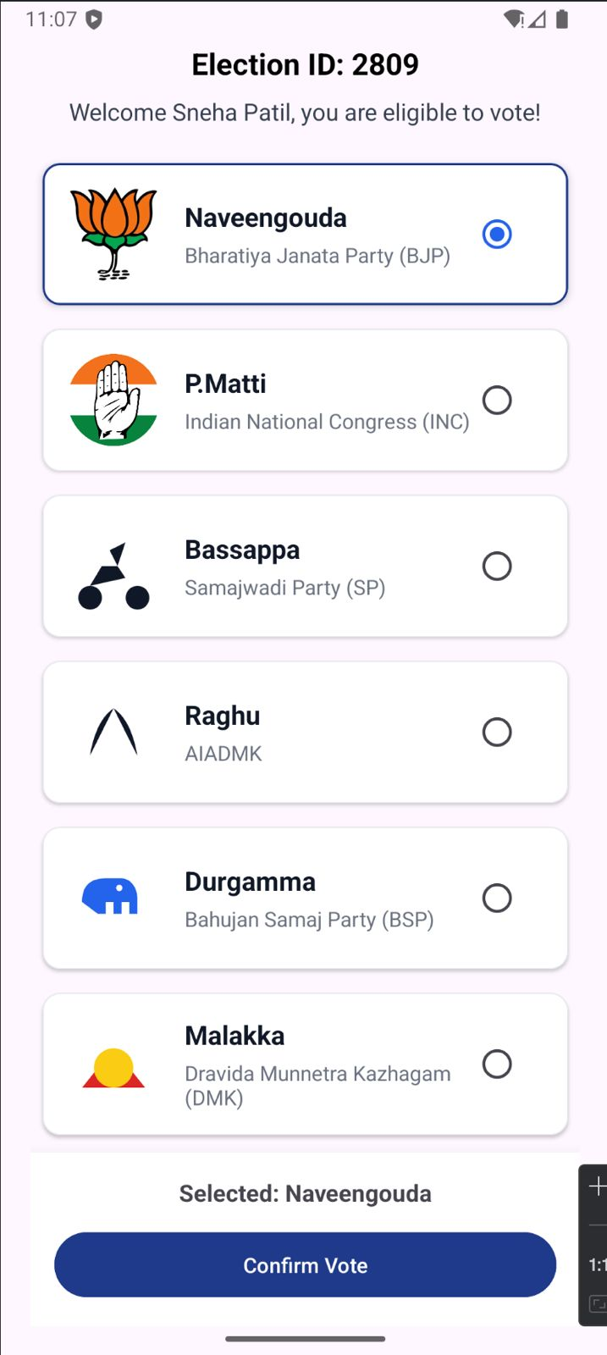
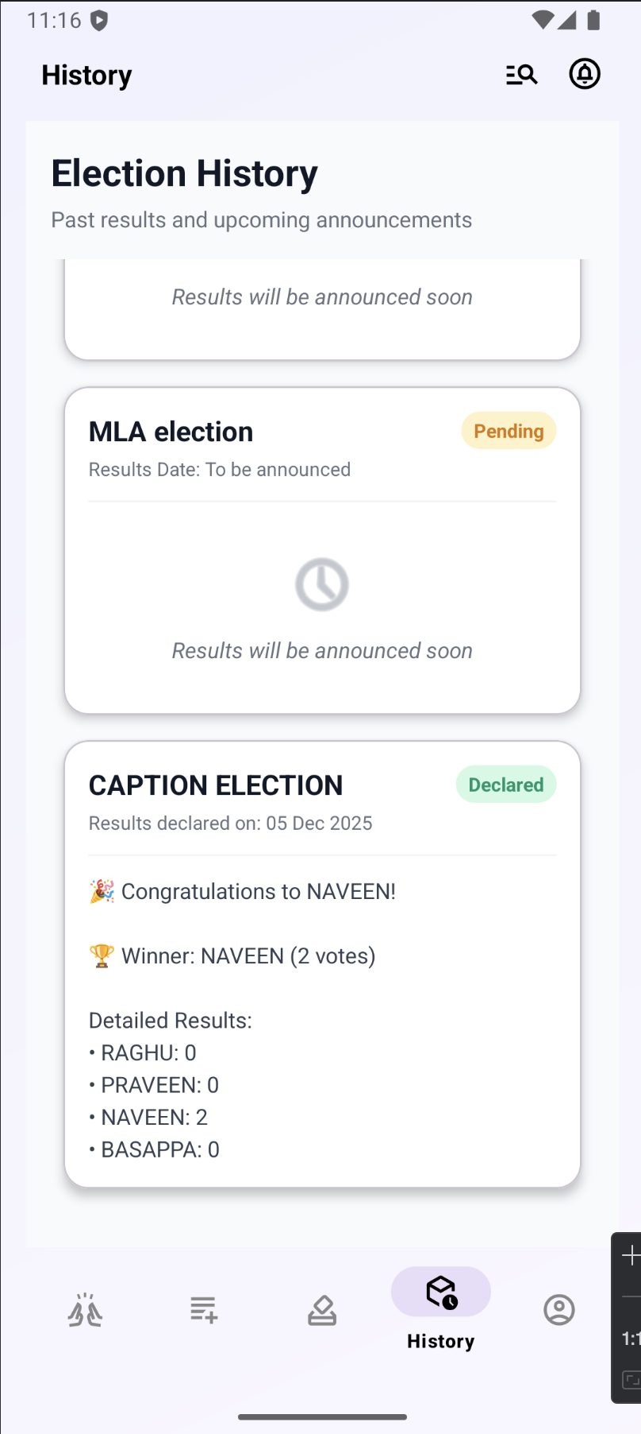
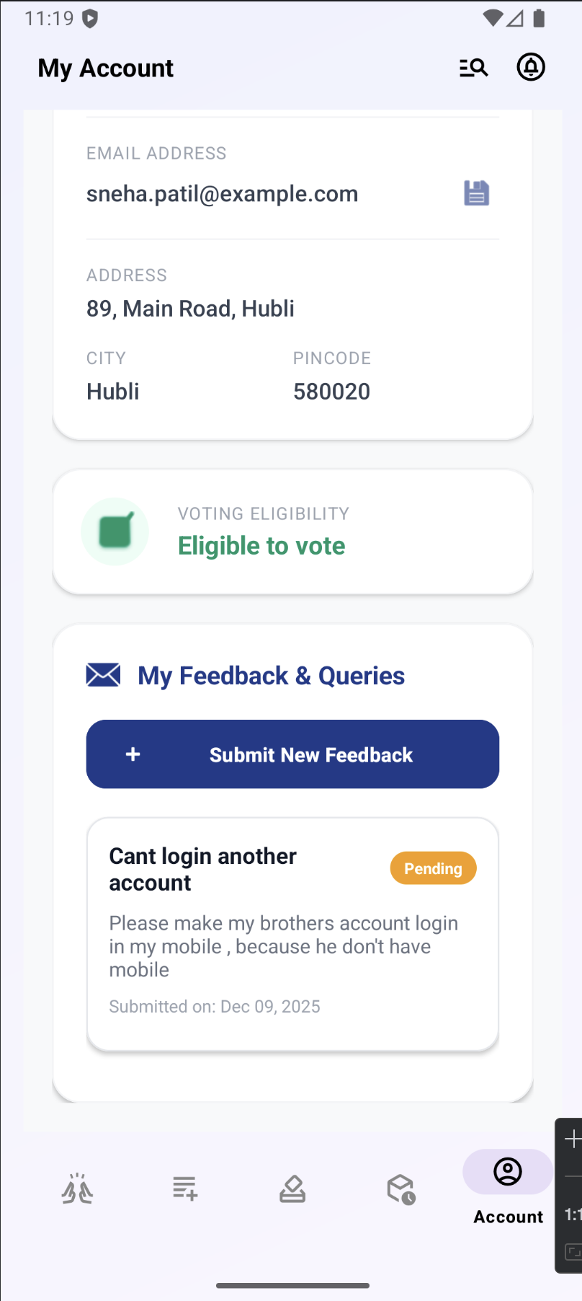
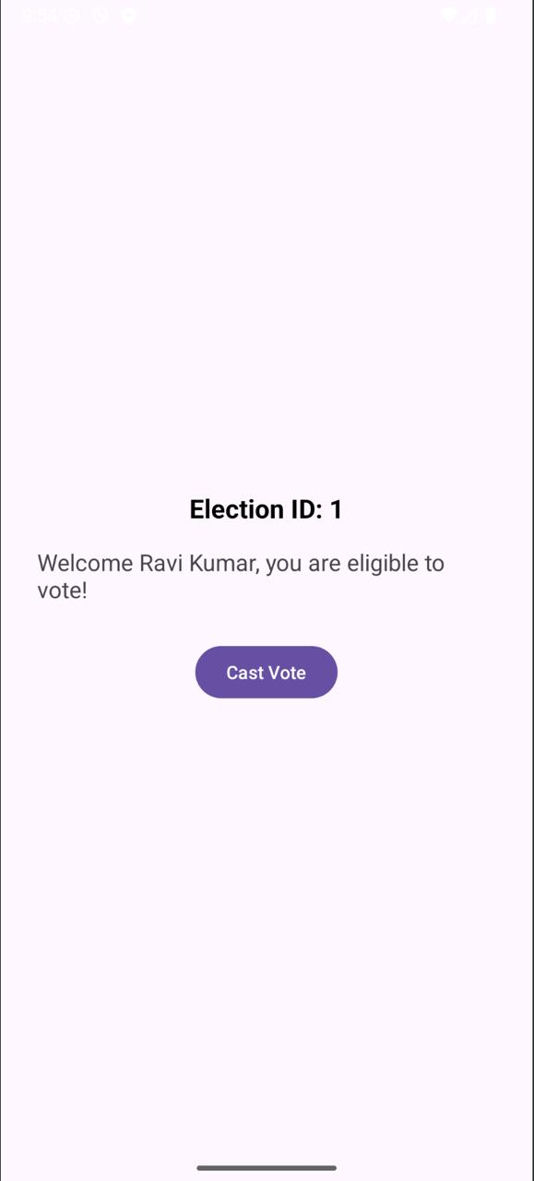
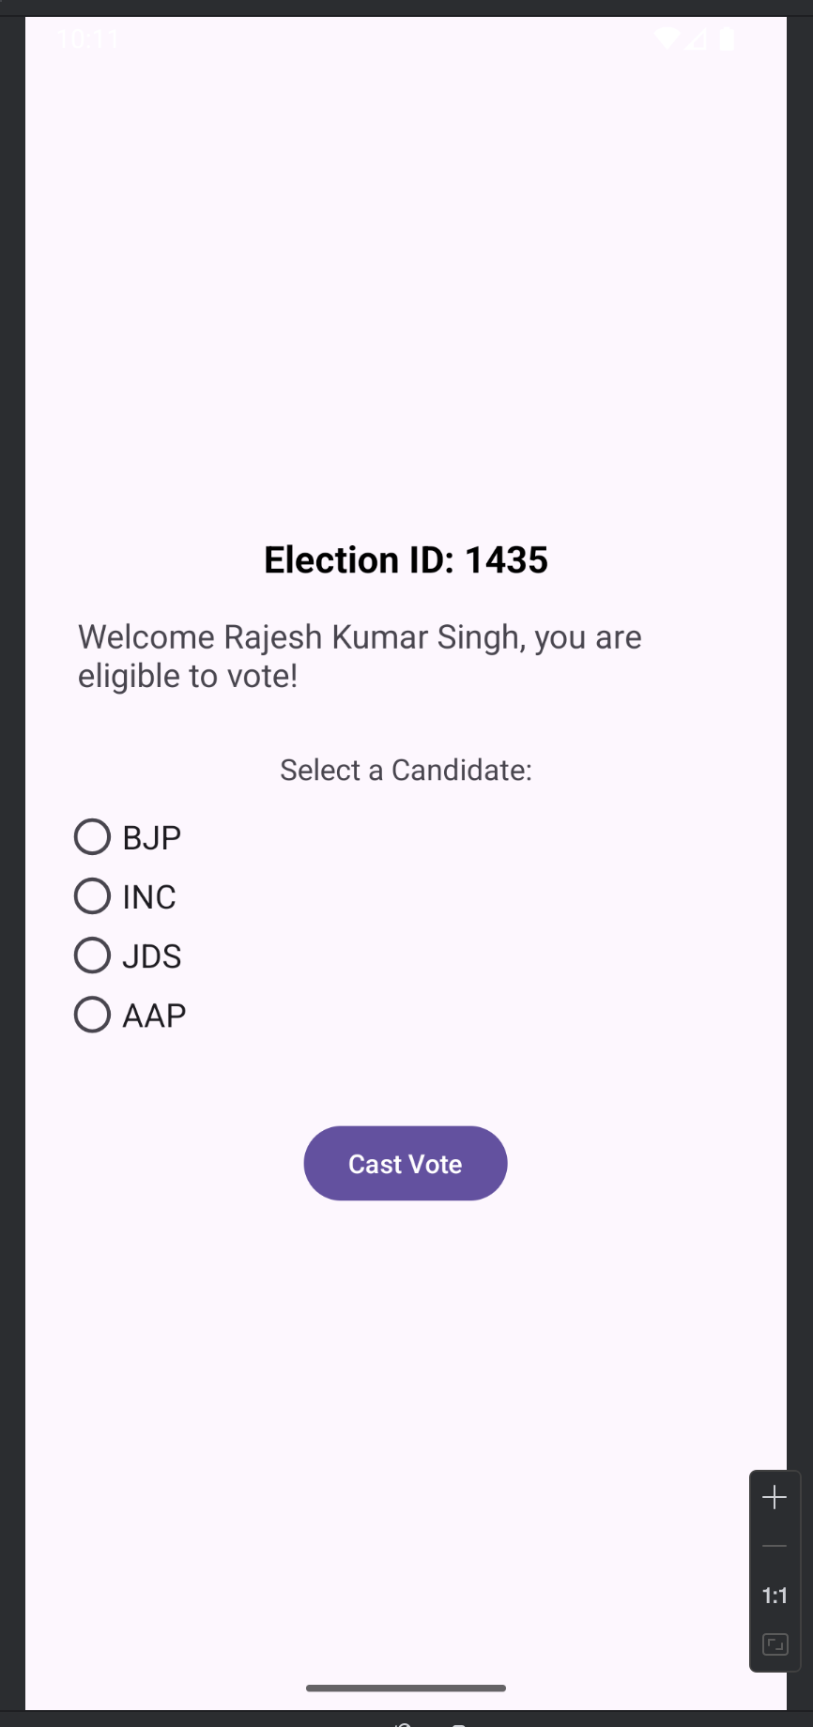

Slide 14
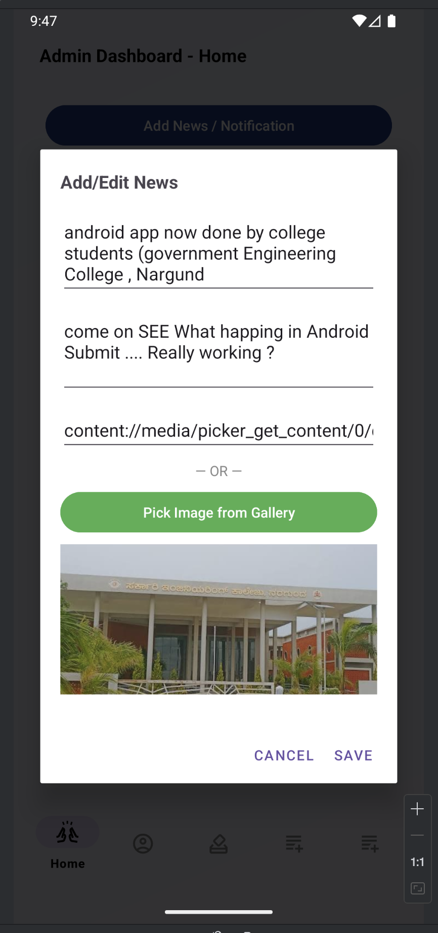
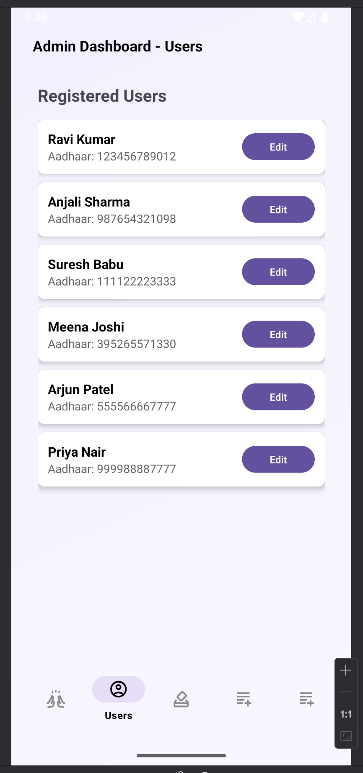
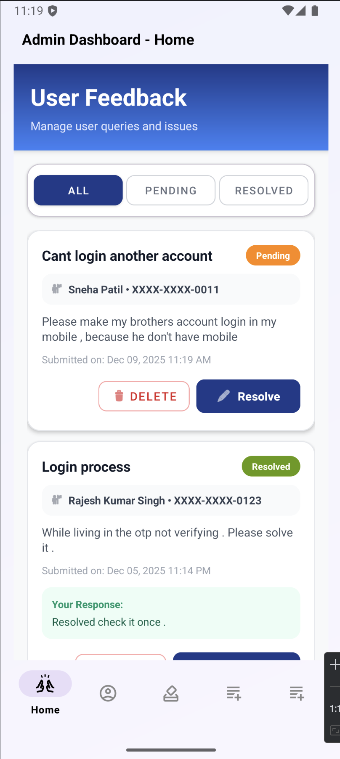
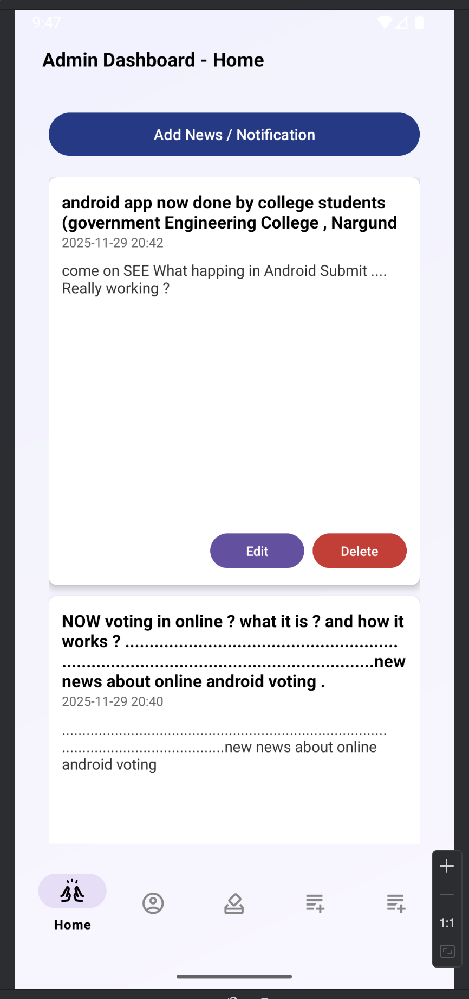

Slide 15
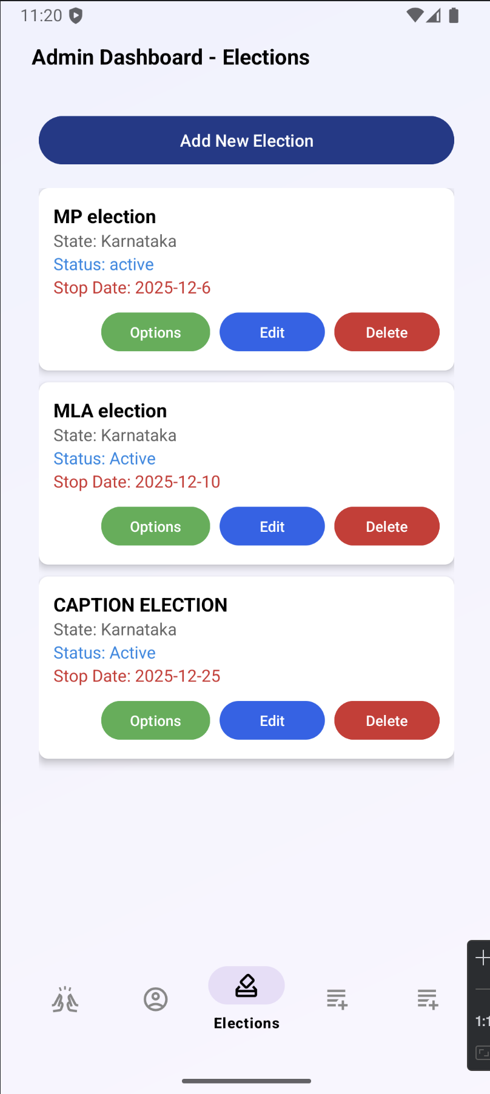
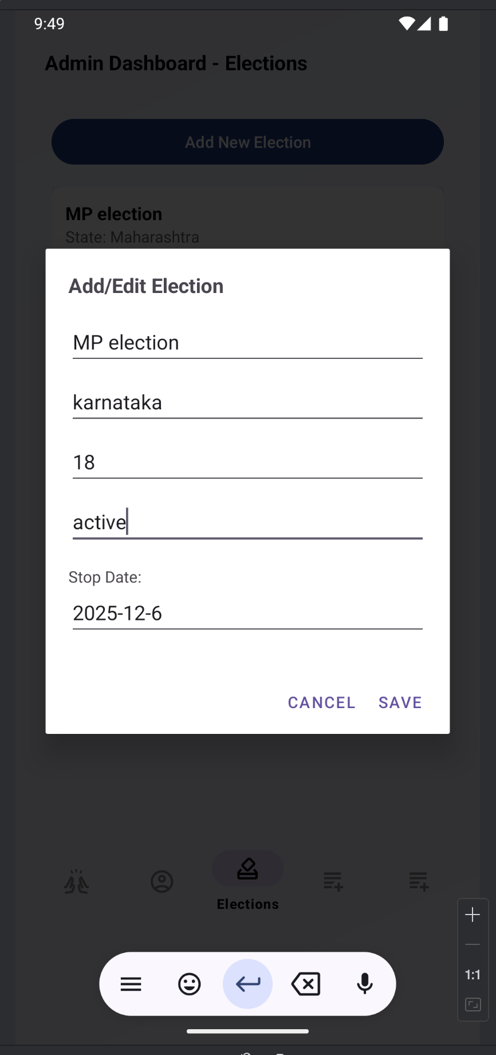
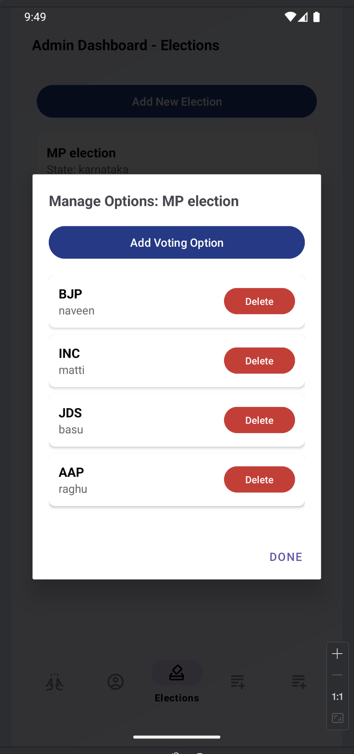
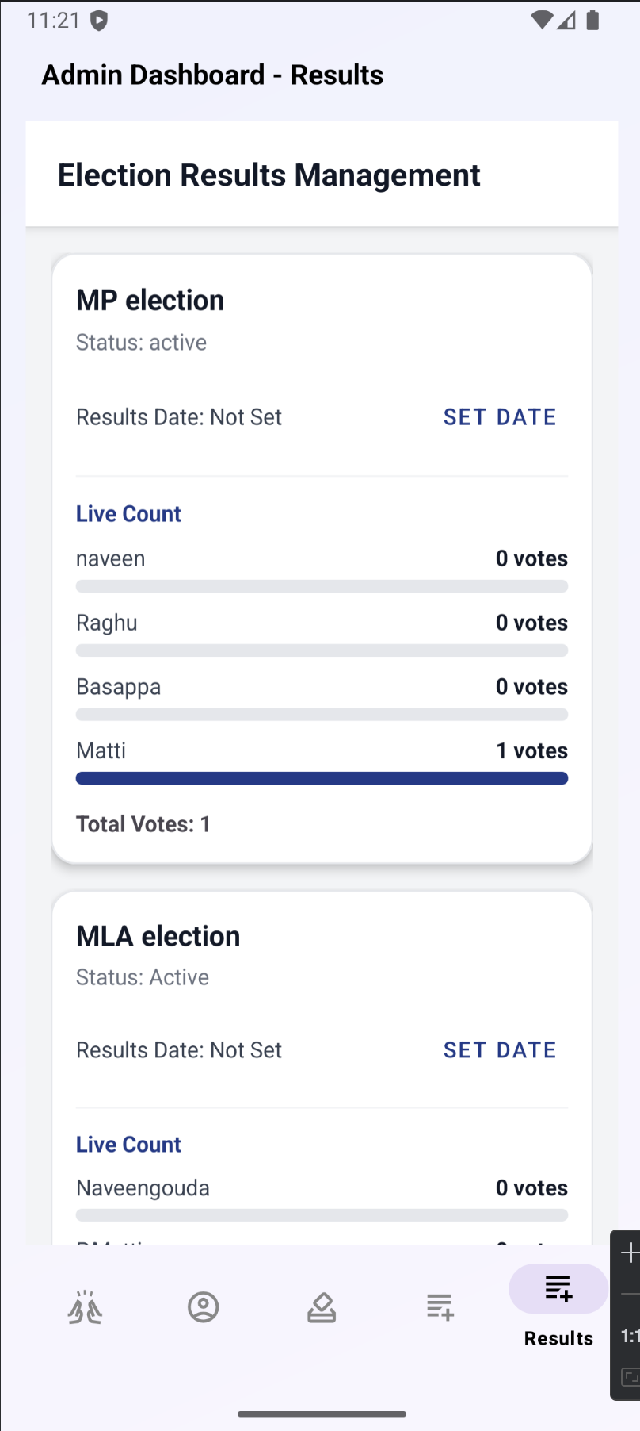

Slide 16
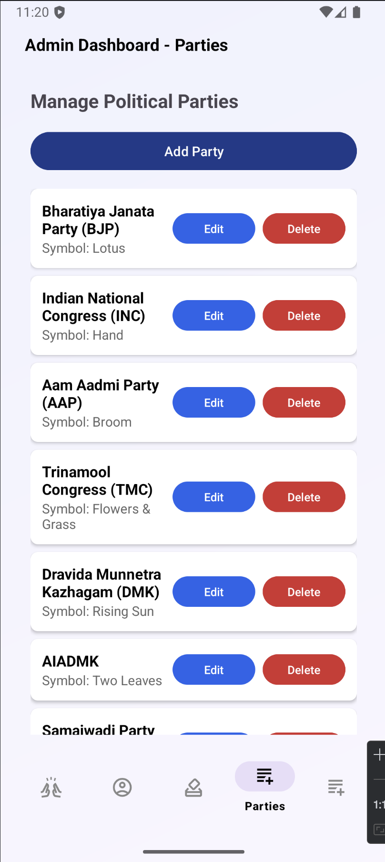
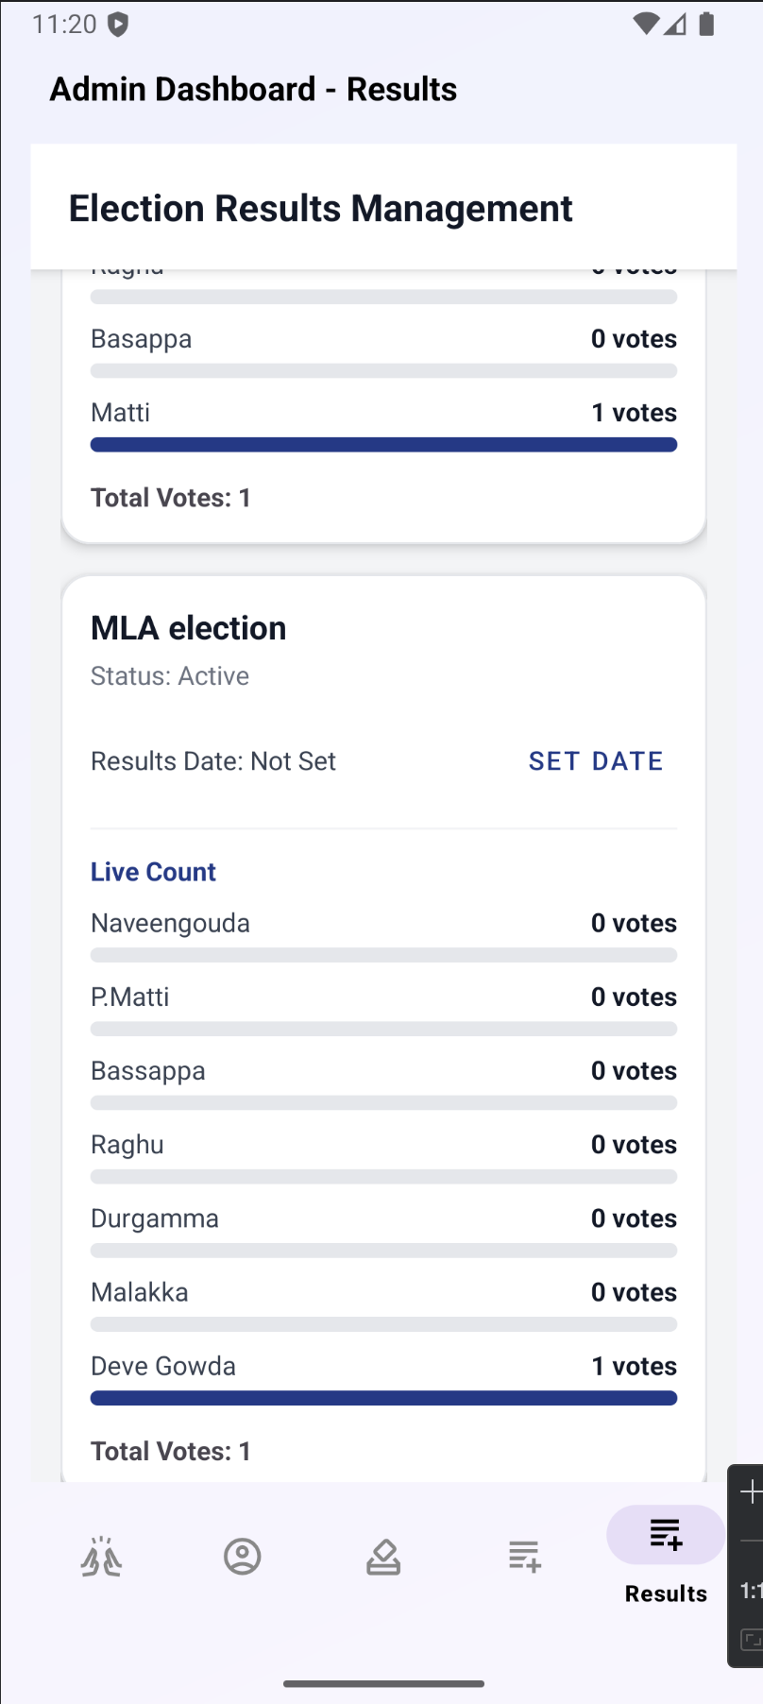
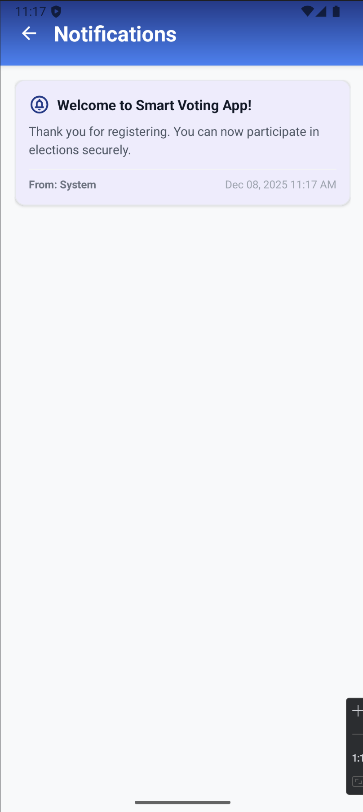
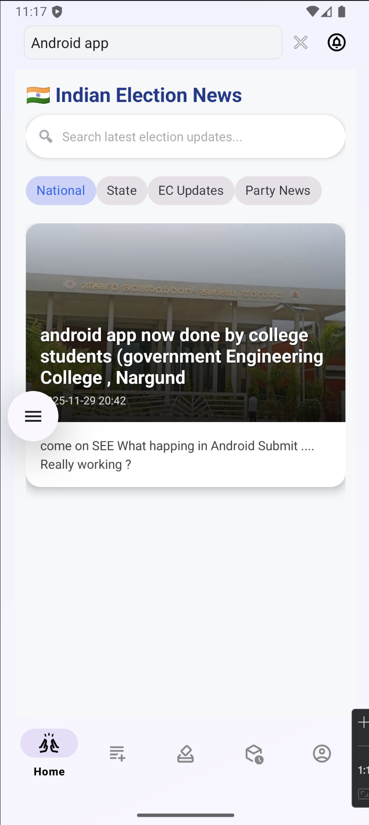

Slide 17
Result Discussions
Secure voter authentication
Prevention of duplicate voting
User-friendly interface
Faster vote counting
Enhanced transparency
Remote voting capability
Reduced human errors
Scalability and flexibility

Slide 18
Conclusion
The Smart Voting System based on ID proof offers a secure, transparent, and efficient solution to modernize the voting process. By integrating ID-based authentication, biometric verification, and digital voting technology, the system ensures voter integrity, prevents fraud, and simplifies the overall election process. It enhances accessibility, especially for remote users, and reduces the chances of human error and tampering. This system has the potential to build trust in digital elections and can be effectively implemented in institutions, organizations, and even national elections with proper infrastructure and legal support.

Slide 19
References
Y. V., M. Udaif P., N. V. S., N. K. Biju, F. Sali, and L. Sebastian, “A Survey on E-Voting Systems Using Blockchain,” International Journal on Emerging Research Areas (IJERA), vol. 4, no. 1, 2024.
Y. Tahboub, A. Revilla, J. Lynch, and G. Floyd, “Blockchain-Based Secure Online Voting Platform Ensuring User Anonymity, Integrity, and End-to-End Verifiability,” arXiv Preprint, 2025.
G. Singh, S. Wable, & P. Kharose, “A Review of E-Voting System Based on Blockchain Technology,” International Journal of New Practices in Management and Engineering, 2021.
4. A. Mishra, S. Khan, A. Meesh, S. Kumar, “Smart Online Voting System:
A Secure and Accessible Solution for Democratic Participation”, IJRASSET 2025

Slide 20
THANKS TOO ….ALL

